Slide 1
Experiment No. -2
Amplitude Modulation and Demodulation

Slide 2
Amplitude Modulation:
Amplitude modulation is a technique of modulation in which the instantaneous amplitude of carrier signal varies in accordance with amplitude of modulating signal.
It is used for radio transmissions for broadcasting and two way radio communication applications.
The frequency and phase of carrier remains constant. Nature of Amplitude Modulated waveform shown below:

Slide 3
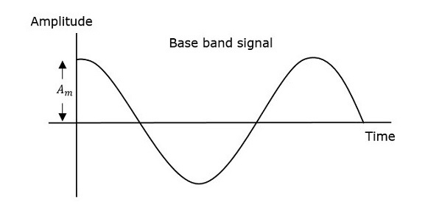
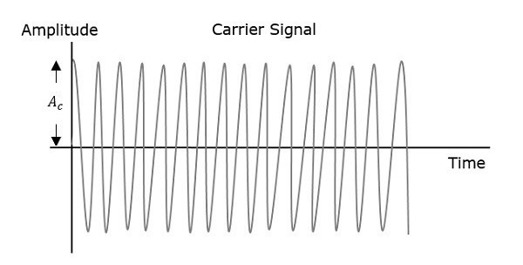
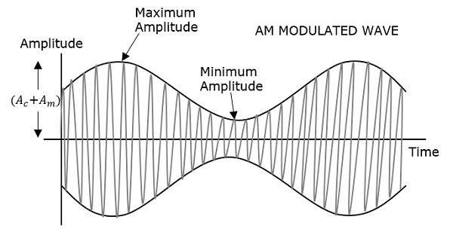
Amplitude Modulation waveform:

Slide 4
In amplitude modulation (AM), auditory or visual information is impressed on a carrier wave by varying the amplitude of the carrier to match the fluctuations in the audio or video signal being transmitted.
AM is the oldest method of broadcasting radio programs. Commercial AM stations operate at frequencies spaced 10 kHz apart between 540 and 1,700 kHz.
Radio waves in this frequency range are effectively reflected back to Earth’s surface by the ionosphere and can be detected by receivers hundreds of kilometers away. In addition to its use in commercial radio broadcasting, AM is employed in long-distance shortwave radio broadcasts and in transmitting the video portion of television programs.

Slide 5
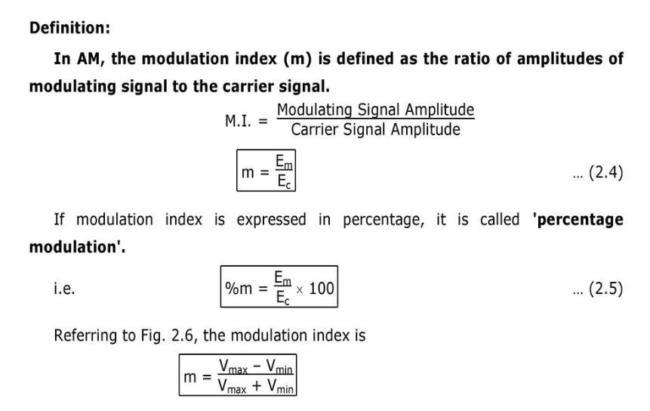
Modulation Index:

Slide 6
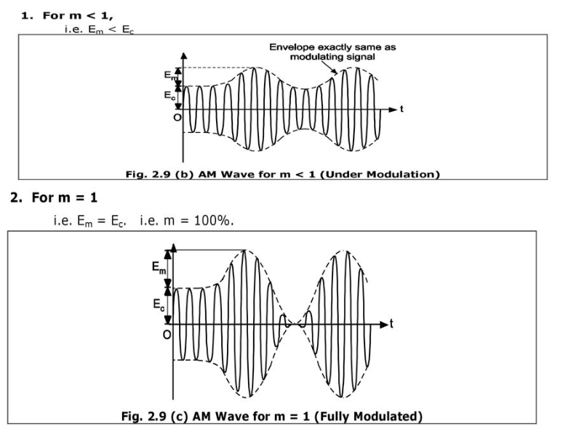
Effect of Modulation Index on Modulated signal

Slide 7
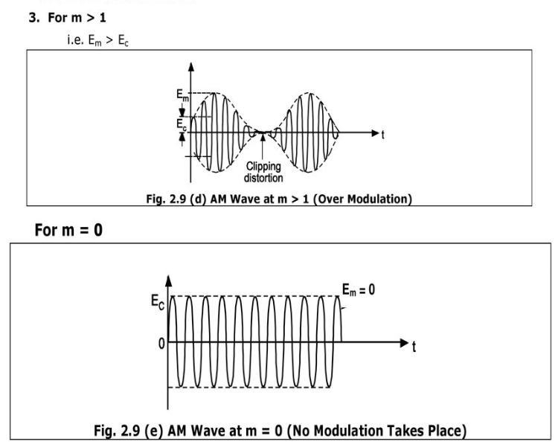

Slide 8
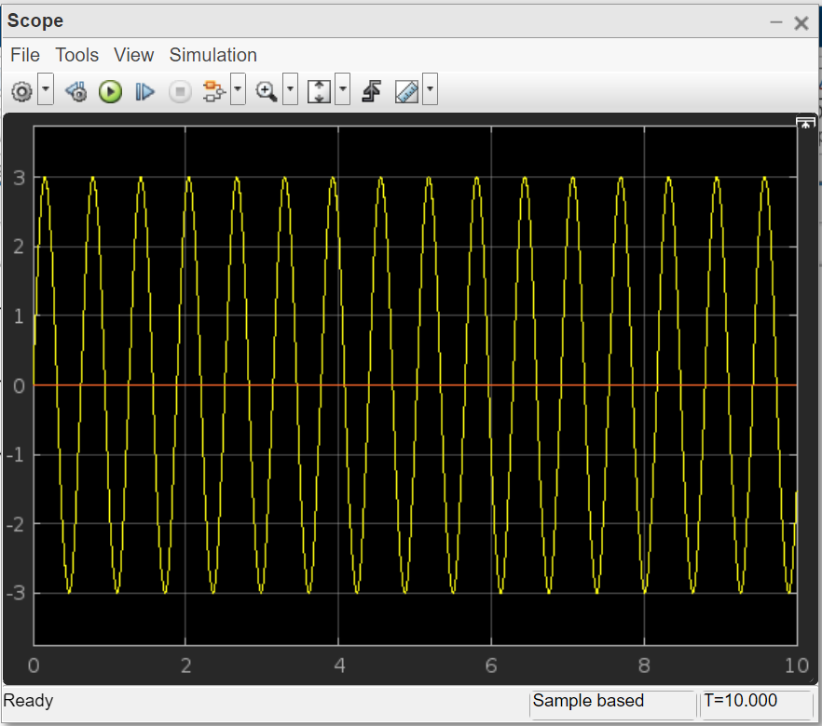
Em=0

Slide 9
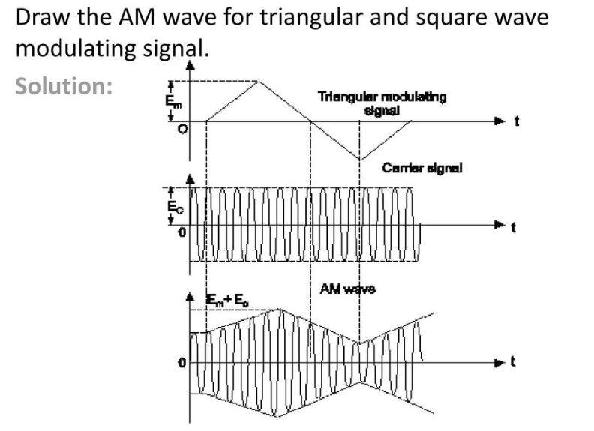
Example:

Slide 10
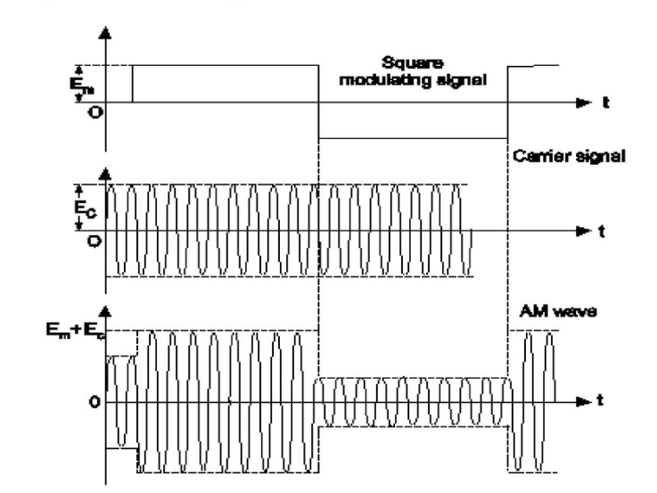
For square wave input:

Slide 11
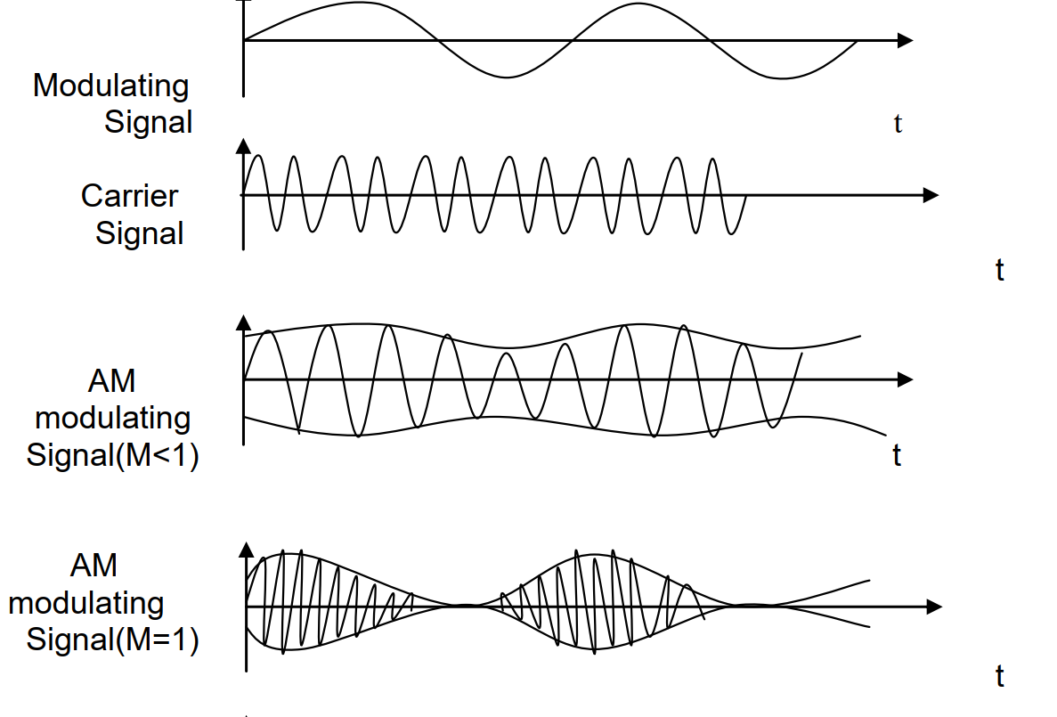
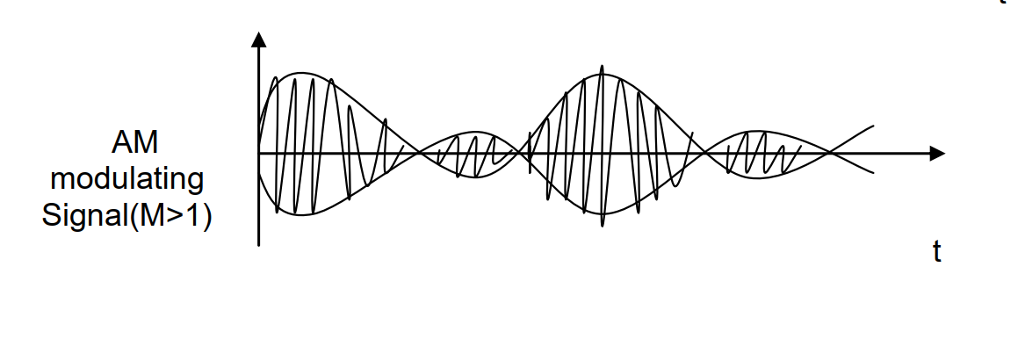
AM Waveform:

Slide 12
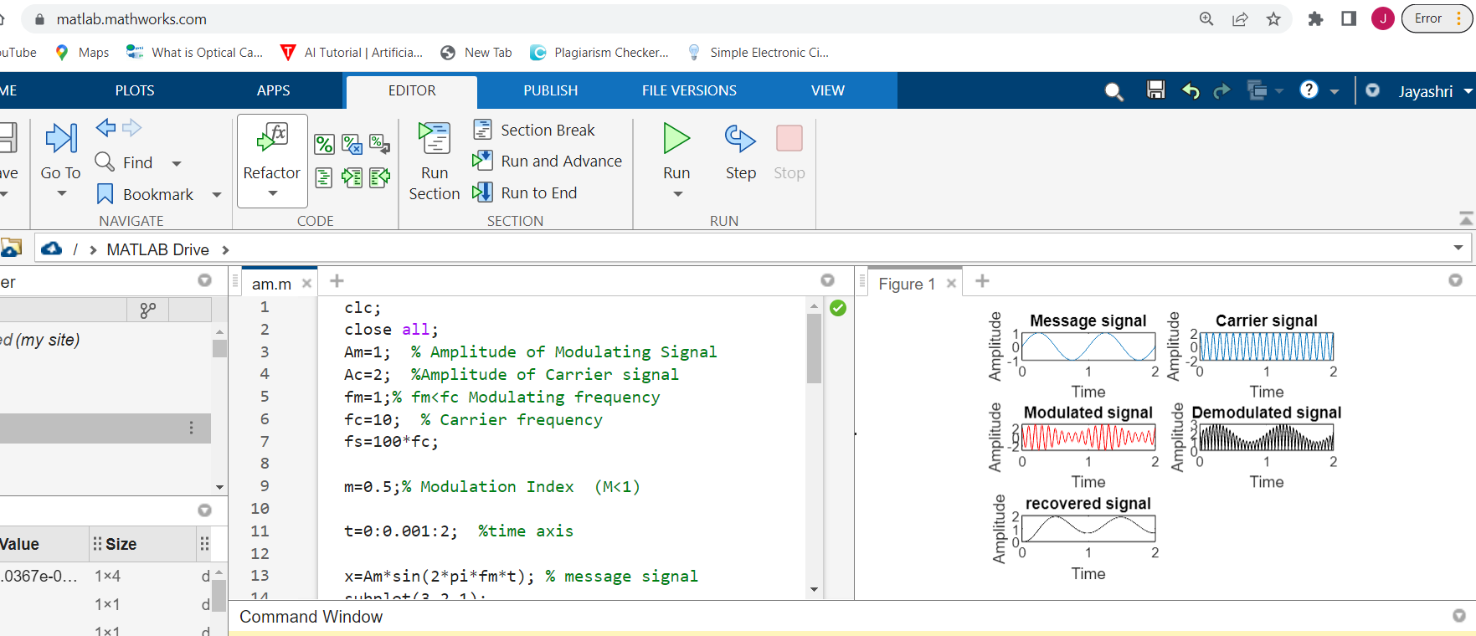
MATLAB Code: Modulation Index: M<1

Slide 13
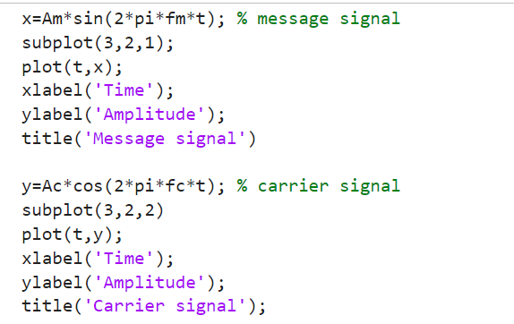
Continue…

Slide 14
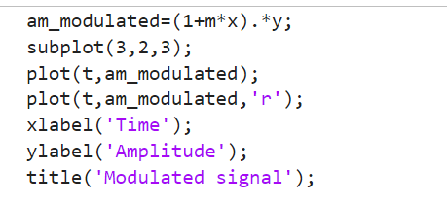
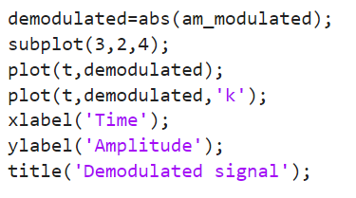
Continue…

Slide 15
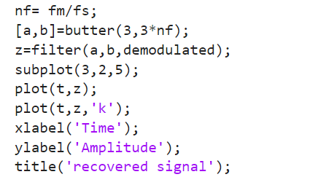
Continue…

Slide 16
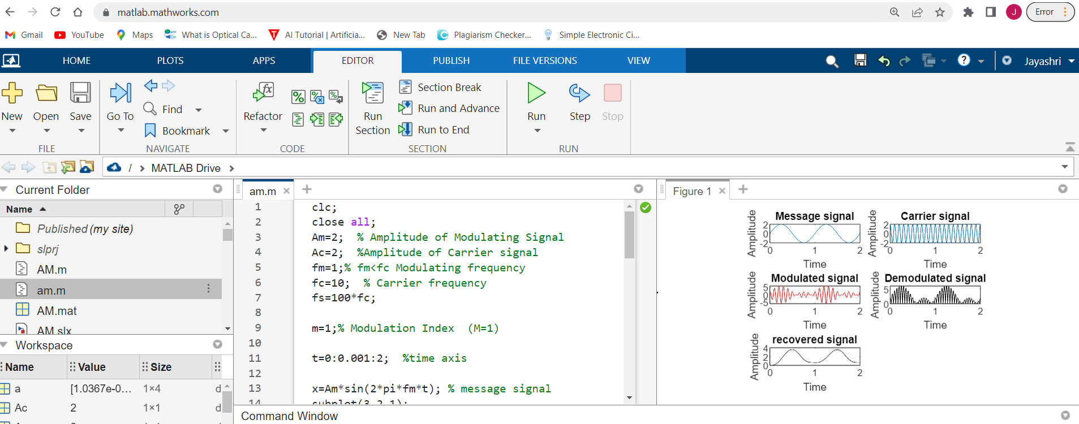
Modulation Index: M=1

Slide 17
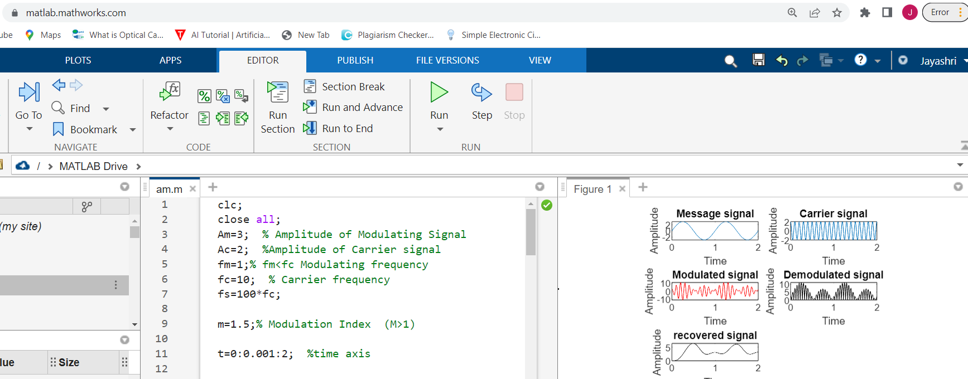
Modulation Index: M>1

Slide 18
Frequency Spectrum:
Representation of AM wave in frequency domain is also known as frequency spectrum of AM wave.
Frequency spectrum is a graph of amplitude versus frequency.
The frequency spectrum of AM wave tells us about number of sideband present in AM wave with corresponding amplitudes.

Slide 19
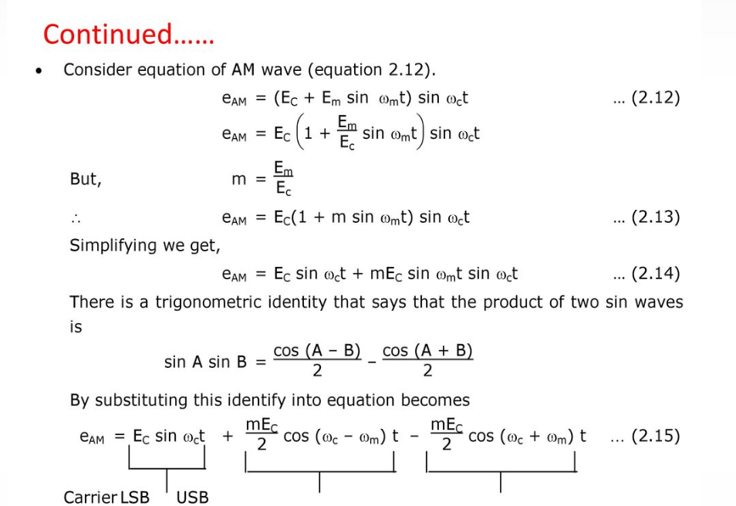

Slide 20
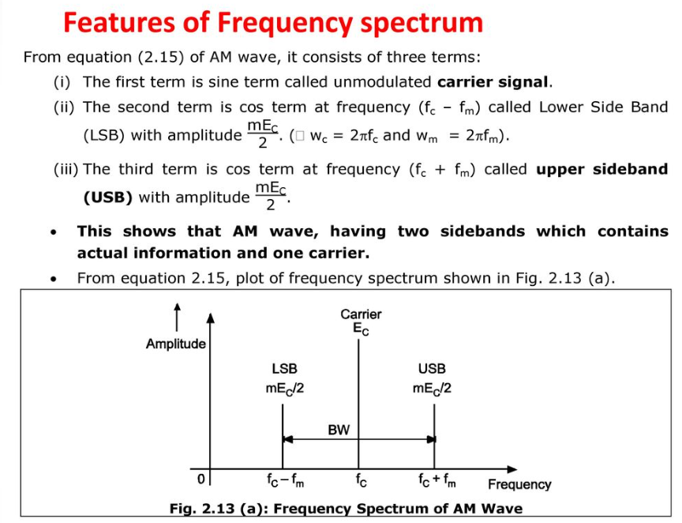

Slide 21
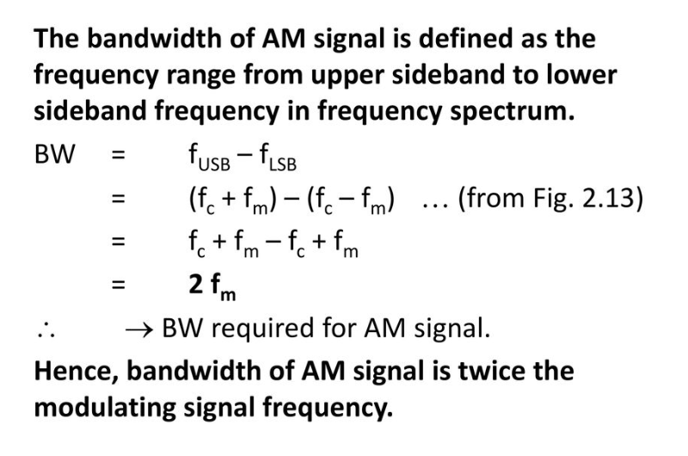
Bandwidth Requirement:

Slide 22
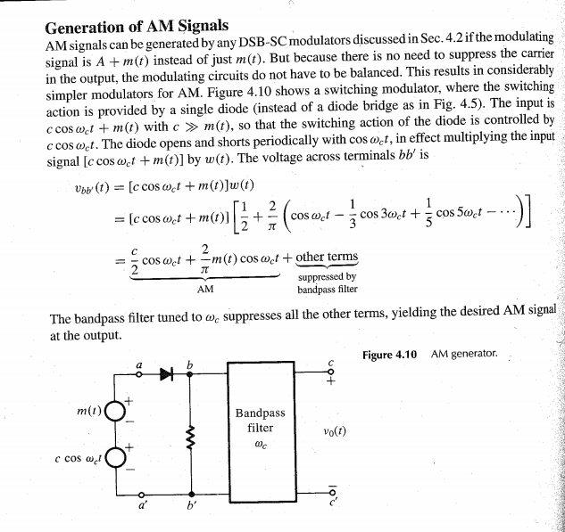

Slide 23
Advantages
It is simple to implement
it can be demodulated using a circuit consisting of very few components
AM receivers are very cheap as no specialized components are needed.
Disadvantages
It is not efficient in terms of its power usage
It is not efficient in terms of its use of bandwidth, requiring a bandwidth equal to twice that of the highest audio frequency
It is prone to high levels of noise because most noise is amplitude based and obviously AM detectors are sensitive to it.

Slide 24
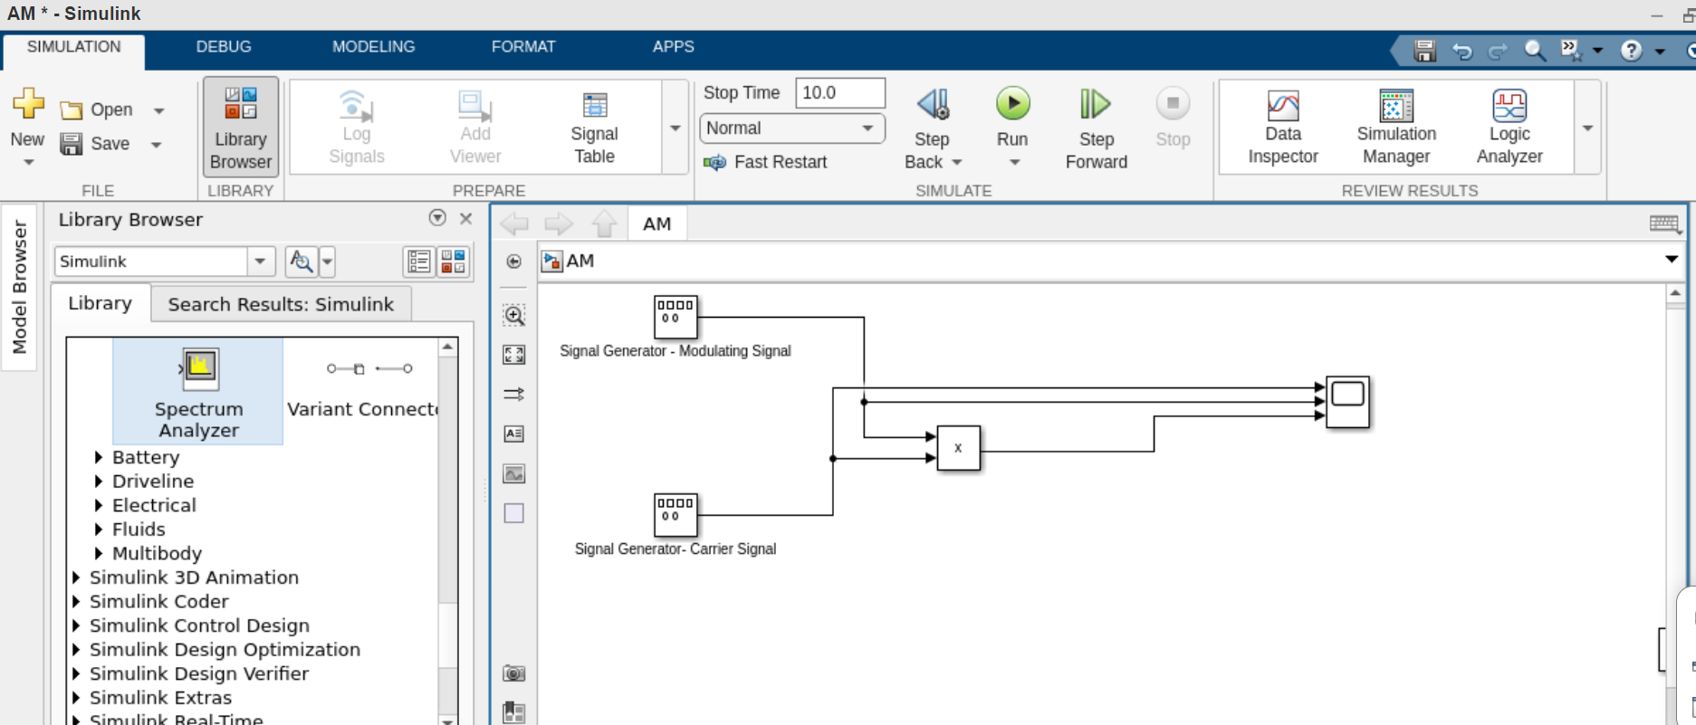
Amplitude Modulation on MATLAB Simulink:

Slide 25
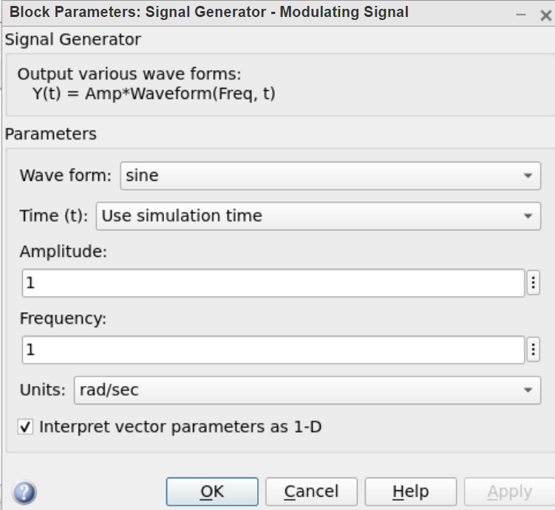
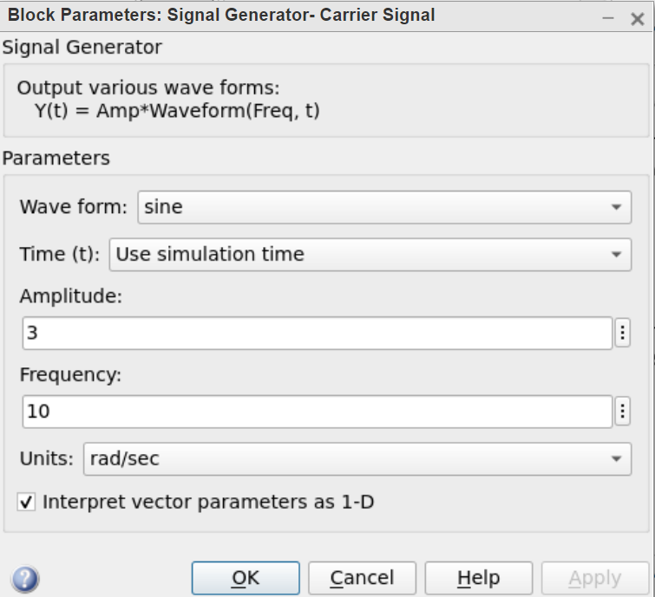
Signal Generator Parameters:

Slide 26
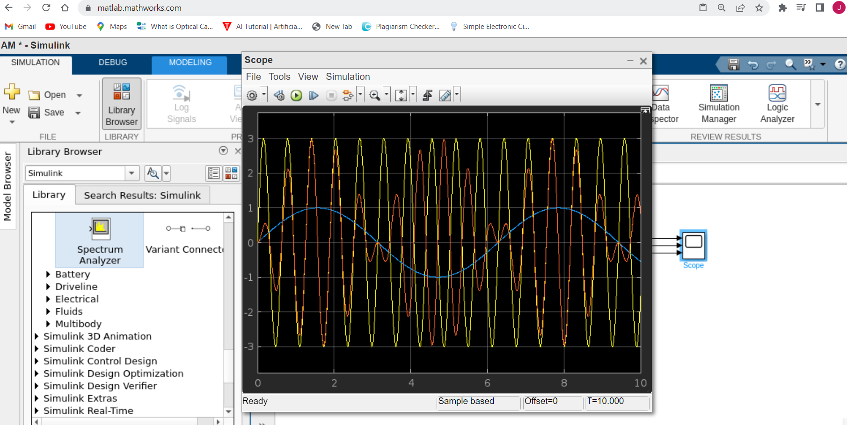
Output on Scope:

Slide 27
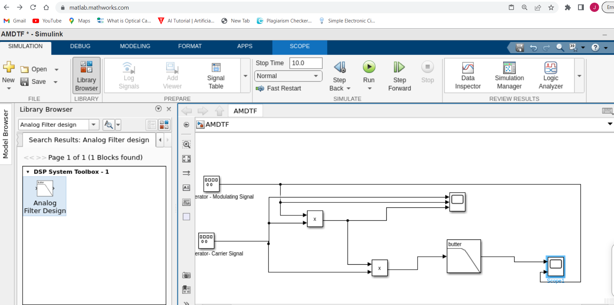
Amplitude Demodulation:

Slide 28
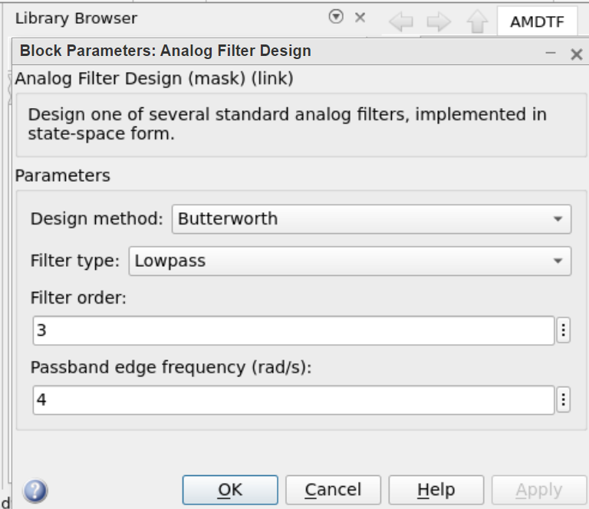
Analog Filter Design:

Slide 29
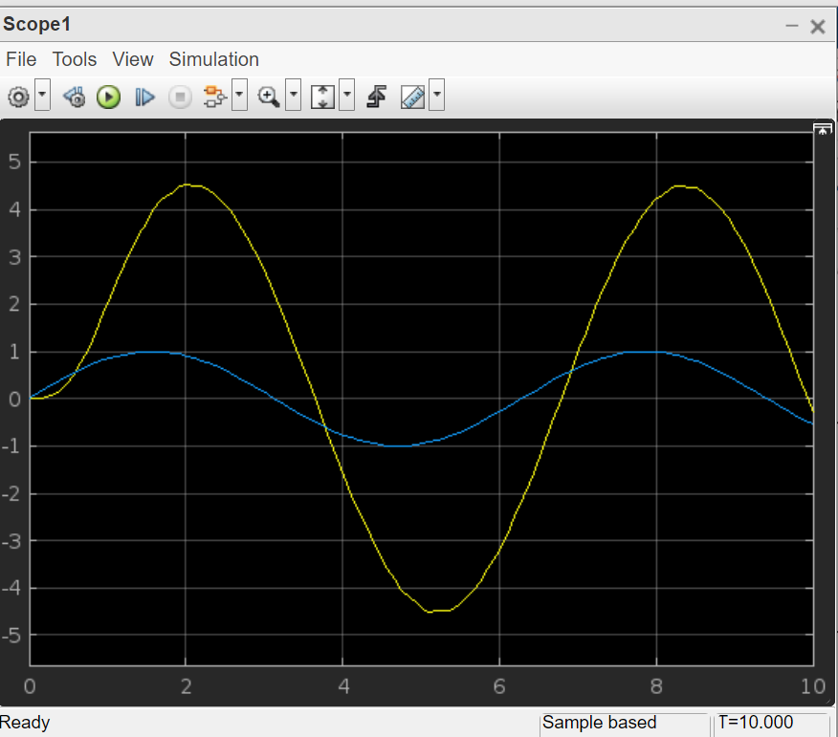
Demodulated Signal:

Slide 30
MATLAB Code: Amplitude modulation in MATLAB can be achieved by using the ammod() function.
Syntax : y = ammod(x, Fc, Fs, ini_phase, carramp) Parameters :
x : amplitude signal
Fc : carrier signal frequency
Fs : sampling frequency
ini_phase : initial phase in the modulated signal y in radians
carramp : carrier amplitude of the modulated signal
Returns : amplitude modulated (AM) signal

Slide 31
AM code in MATLAB:
% carrier Frequency
Fc = 200;
% sampling frequency
Fs= 4000;
% time Duration
t = (0 : 1 / Fs : 1);
% sine Wave with time duration of 't'
x = sin(2*pi*t);
% Amplitude Modulation
y = ammod(x, Fc, Fs);
plot(y);
title('Amplitude Modulation');
xlabel('Time(sec)');
ylabel('Amplitude');

Slide 32
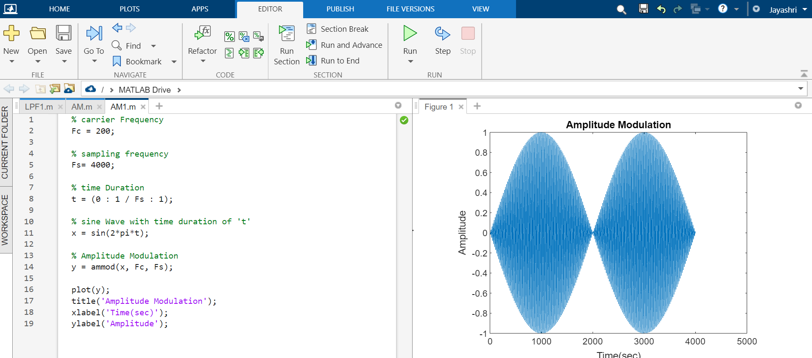

Slide 33
References:
[1]https://www.electronicsnotes.com/articles/radio/modulation/amplitude-modulation-am.php
[2] https://www.youtube.com/watch?v=7fwb2N2QTxY
[3] “B.P.Lathi”, Modern Digital and Analog Communication Systems Chapter 4.
[4] https://www.vedantu.com/physics/amplitude-modulation
[5] https://slideplayer.com/slide/12185195/
[6]https://www.tutorialspoint.com/analog_communication/analog_communication_amplitude_modulation.htm
[7] https://www.geeksforgeeks.org/amplitude-modulation-using-matlab/

